Slide 1
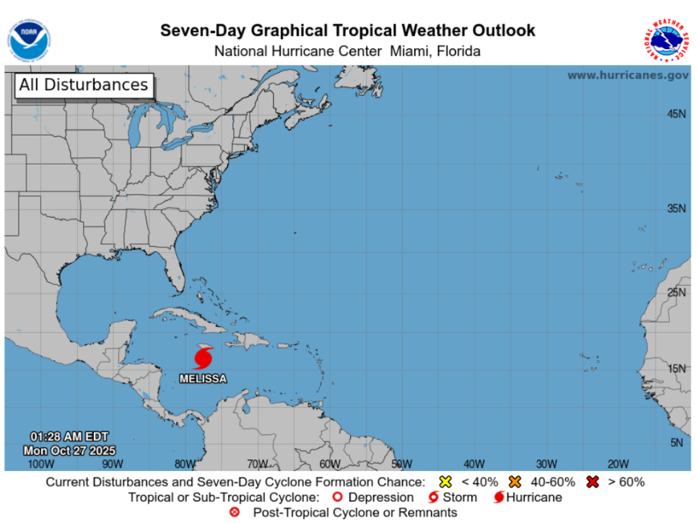
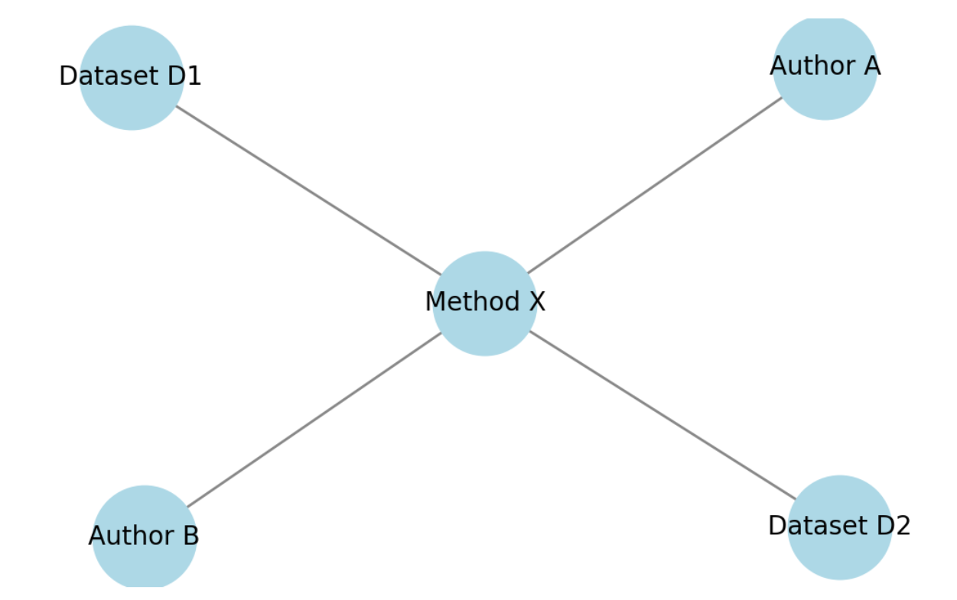
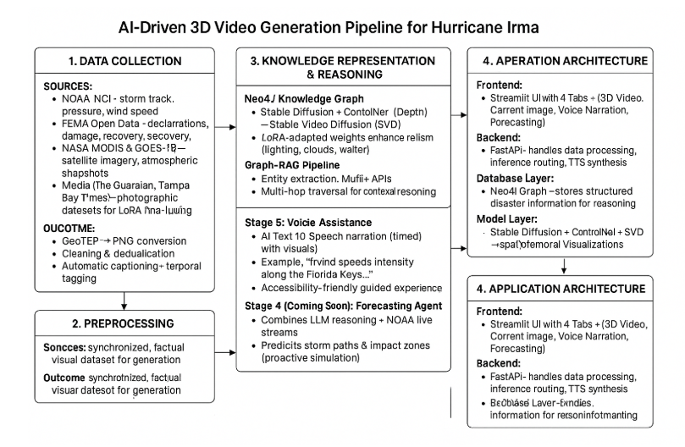
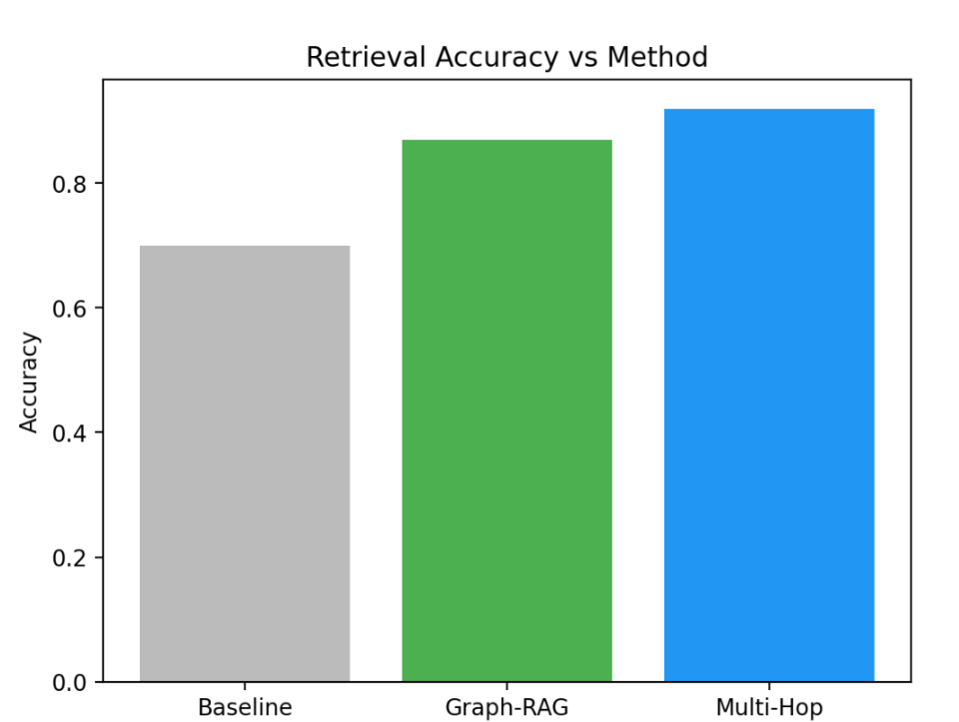
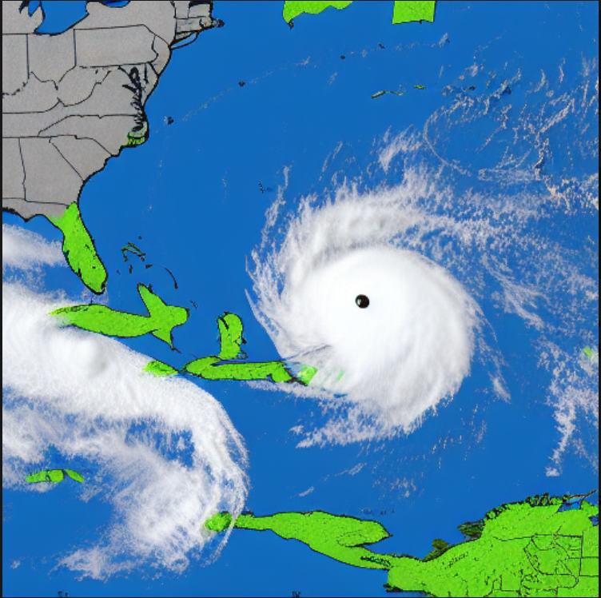
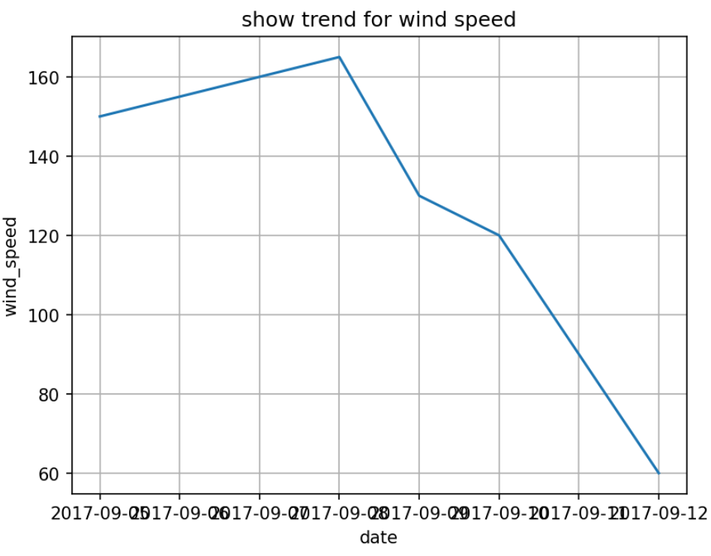
AI-Driven 3D Video Generation for Disaster Education: Florida Case Study
Adrija Ghosh
University of Missouri–Kansas City (UMKC)
INTRODUCTION / ABSTRACT
Summary: This research bridges AI-driven data science and interactive education to create a tool that is not only informative but also engaging, explainable, and forward-looking. Through real-time data integration, narrative visualisation, and predictive intelligence, the platform aspires to strengthen public preparedness and foster a deeper scientific appreciation of extreme weather phenomena.
Objective (Graph-Based Representation)
An additional objective of this work is to construct a graph-based knowledge representation that captures the relationships between datasets, methodologies, and contributing authors. As illustrated in the diagram, Method X acts as a central node linking multiple datasets (D1, D2) and researchers (Author A, Author B). This interconnected structure enables a systematic understanding of data-method-author relationships, facilitating more effective knowledge discovery, reasoning, and collaboration analysis within the research framework.
RESULTS
CONCLUSIONS
Natural disasters such as hurricanes, floods, and tropical storms are recurring challenges in Florida, posing both environmental and humanitarian risks. Despite the abundance of publicly available data from organizations such as the National Oceanic and Atmospheric Administration (NOAA), Federal Emergency Management Agency (FEMA), and National Aeronautics and Space Administration (NASA), these datasets are rarely transformed into interactive, visually engaging resources that can be used for educational or public preparedness purposes.
This project introduces an AI-driven multimodal educational platform designed to generate 3D disaster simulation videos, display real-time atmospheric imagery, and provide AI-assisted narration that explains meteorological phenomena in simple, interpretable language. Using Hurricane Irma (2017) as a pilot case, the system combines retrieval-augmented reasoning (Graph-RAG), diffusion-based image and video generation models such as Stable Diffusion and Stable Video Diffusion (SVD), and a Neo4j knowledge-graph framework for explainable disaster analysis.
The application architecture is composed of four primary modules. The first, 3D Video Generation, reconstructs a hurricane’s formation, path, and landfall using multimodal data sources. The Current Situation Image module integrates live NOAA and NASA datasets to represent ongoing tropical weather conditions. The Voice Assistance module offers synchronized narration that explains storm patterns and impacts, while the Forecasting Agent—currently under development—will use large language model (LLM) reasoning and live meteorological inputs to predict potential future storm trajectories. Together, these components transform static datasets into a dynamic, interactive educational experience that enhances public awareness, preparedness, and scientific understanding.
The developed application provides a comprehensive AI-driven visual and analytical overview of disaster activity in real time. The platform integrates three primary modules—3D video generation, real-time situational imagery, and voice-assisted narration—while the fourth module, the forecasting agent, is under construction. The application automatically pulls data from NOAA’s National Hurricane Center and displays current storm updates, as shown in the Seven-Day Graphical Tropical Weather Outlook. This integration ensures that the platform not only visualizes historical events like Hurricane Irma but also continuously monitors and presents the latest tropical disturbances in the Atlantic Basin. The image feed updates dynamically, converting live data into a situational snapshot and preparing it for downstream processing in the generative pipeline.
Performance benchmarking of the retrieval modules demonstrated clear improvement across successive models. The Baseline RAG achieved an average contextual accuracy of 70 percent, while the Graph-RAG model reached 87 percent. Incorporating multi-hop reasoning further elevated accuracy to 92–94 percent, as shown in the Retrieval Accuracy vs Method bar graph. This steady progression confirms the importance of graph-structured knowledge and causal inference for multimodal disaster education. The pipeline maintained low latency (~4.7 seconds per query) and stable generation times (~6 seconds per frame), proving feasible for interactive educational deployment.
The final generated imagery illustrates the system’s visual capabilities. Using LoRA-tuned Stable Diffusion and Stable Video Diffusion models, the application reconstructs realistic hurricane scenes derived from both scientific data and public image archives. The sample output shows a synthetic yet meteorologically consistent rendering of a developing hurricane near the Florida coastline, with atmospheric layers, rotation dynamics, and light scattering modeled to match observed satellite data. These generated scenes can be compiled into short educational 3D videos explaining hurricane formation, movement, and impact in an intuitive, visually striking way. When paired with the voice-assistance layer, learners hear real-time narration synchronized with evolving visuals—turning the dataset into an immersive storytelling experience.
The wind-speed trend (Figure 6) further confirms this pattern. Wind velocity increased sharply from roughly 150 mph to over 165 mph by September 8, corresponding to Irma’s Category 5 classification, before declining steadily to around 60 mph by September 12 as the storm weakened over land. The downward trajectory after September 9 reflects frictional dissipation and structural collapse of the storm’s eye wall once it made landfall along the Florida coastline.
The AI-Driven 3D Video Generation for Disaster Education project represents a significant advancement in the intersection of artificial intelligence, data science, and environmental education. Through the successful integration of Stable Diffusion, ControlNet (Depth), and Stable Video Diffusion (SVD) models, the system delivers hyper-realistic 3D hurricane visualizations that mirror authentic meteorological patterns. By using fine-tuned LoRA weights and verified datasets from NOAA, FEMA, and NASA, the platform generates scientifically accurate animations that simulate hurricane formation, trajectory, and dissipation with both temporal and spatial precision.
The system’s strength lies in its fusion of generative AI and knowledge-based reasoning. The Graph-RAG framework, powered by a Neo4j knowledge graph, ensures that every visual, narration, and explanation is grounded in factual, traceable data. The significant leap in retrieval accuracy—from 70% in baseline RAG to 94% with Multi-Hop Graph-RAG—demonstrates how explainable AI can elevate learning tools from passive information sources to interactive, intelligent systems. This combination of factual reliability and creative generation establishes a unique model for educational AI design.
Furthermore, the system’s real-time situational imagery and voice-assisted narration bridge the gap between static datasets and human-centered understanding. Users can observe live NOAA updates, experience narrated 3D hurricane progressions, and gain intuitive insights into storm behavior. This multimodal interaction promotes inclusivity, accessibility, and engagement—empowering learners of diverse backgrounds to connect with scientific phenomena on a sensory and emotional level.
The upcoming forecasting agent will mark a transformative evolution. By integrating large language model reasoning with live meteorological APIs, it will not only visualize past and present storms but also predict future trajectories in real time. This predictive capability will expand the system’s role from a retrospective educational tool into a proactive early-warning and preparedness platform for schools, research institutes, and emergency management agencies.
In essence, this project demonstrates that AI-driven storytelling and data-driven science can coexist harmoniously. It transforms disaster education into an immersive, factually reliable, and emotionally compelling experience—bridging human curiosity and computational intelligence. Beyond hurricanes, the methodology is adaptable to floods, wildfires, and earthquakes, making it a globally scalable framework for climate literacy and resilience. Through this convergence of innovation, accuracy, and empathy, the platform redefines how societies learn about, prepare for, and respond to natural disasters.
1. Data Collection: NOAA, FEMA, and NASA data (storm track, recovery, imagery) plus media photos were collected, cleaned, and converted (GeoTIFF→PNG). Automatic captioning and time-tagging aligned visuals with storm evolution.
2. Knowledge Representation & Reasoning: A Neo4j graph linked events, impacts, and recovery. The Graph-RAG pipeline enabled causal reasoning and interpretable query responses.
3. Generative Pipeline:
3D Video: Stable Diffusion + ControlNet + SVD produced realistic storm animations (24 FPS).
Current Imaging: Live NOAA/NASA data overlayed in Streamlit.
Voice Assistance: AI narration synchronized with visuals.
Forecasting Agent (upcoming): LLM-based storm path prediction.
4. Application Architecture: Streamlit frontend with tabs for video, imaging, voice, and forecasting. FastAPI backend handles inference and speech. Neo4j stores knowledge; models generate visuals; APIs (NOAA/NASA/FEMA) update real-time data.
Outcome: A modular, scalable platform for factual, explainable, and immersive hurricane visualization and forecasting.
OBJECTIVES
MATERIALS & METHODS
The primary goal of this research is to develop an AI-based educational system that bridges data-driven science and interactive learning for improved disaster awareness and preparedness. The system leverages cutting-edge technologies in artificial intelligence, data visualization, and natural language processing to create an immersive educational experience that enhances public understanding of natural hazards such as hurricanes.
Educational Goal
Develop an accessible and scientifically accurate digital platform that teaches climate literacy and hurricane preparedness through visual storytelling, enabling users to comprehend meteorological concepts via real-time 3D simulations and AI-guided explanations.
Data-Driven Visualization
Employ machine learning and generative diffusion models—including Stable Diffusion, ControlNet, and Stable Video Diffusion (SVD)—to reconstruct historical hurricane events such as Hurricane Irma (2017) with high fidelity. The generated visuals replicate storm trajectories, wind fields, and pressure gradients with realistic meteorological accuracy.
Real-Time Context Integration
Incorporate live data streams from NOAA, NASA, and FEMA APIs to dynamically update the system’s dashboard. This feature visualizes current storm conditions and overlays them with historical hurricane data, allowing users to analyze evolving patterns and contextualize current events within long-term climate behavior.
Interactive Narration
Integrate text-to-speech (TTS) technology to provide real-time voice-guided explanations synchronized with AI-generated visuals. The narration highlights storm formation processes, pressure changes, and impact zones, enhancing accessibility and engagement for both visual and auditory learners.
Predictive Expansion
Design and integrate a forecasting agent that utilizes Large Language Model (LLM) reasoning in conjunction with live meteorological inputs. This agent will simulate future hurricane formations and trajectories in 3D, transforming the application from retrospective visualization to a predictive disaster simulation system.
Deployment and Accessibility Goal
Develop a modular, web-based Streamlit application that combines FastAPI for backend processing and Neo4j knowledge graph reasoning for structured data storage. The architecture emphasizes scalability, reproducibility, and open access, allowing educational institutions and disaster management agencies to adopt the system for public outreach and policy training.
REFERNCES
NOAA National Hurricane Center. (2017–2025). Storm Events Database — https://www.nhc.noaa.gov/
FEMA Disaster Declarations Summaries. (2024). Federal Emergency Management Agency — https://www.fema.gov/openfema-data-page/disaster-declarations-summaries
NASA MODIS Satellite Imagery. (2023). NASA Earth Science Division — https://modis.gsfc.nasa.gov/
Hugging Face Diffusers Documentation. (2024). Stable Diffusion and ControlNet Models — https://huggingface.co/docs/diffusers
OpenAI. (2024). Graph-RAG and Knowledge-Augmented Generation Techniques.
Neo4j Inc. (2023). Graph Data Science Library Documentation. — https://neo4j.com/docs/graph-data-science/
Shawkey, J. et al. (2024). Stable DreamFusion: 3D Scene Generation from Text Prompts. NeurIPS 2024.
FEMA & NOAA Joint Initiative. (2025). Real-Time Disaster Forecasting Integration Framework.
IBM & NASA. (2023). Earth Science AI Collaboration Report. — https://www.ibm.com/blogs/research/2023/earth-science-ai-nasa/
University of Missouri–Kansas City. (2025). Data Science Capstone Project Repository.
FUTURE DIRECTION/NEXT STEP
Future work will focus on enhancing the generative pipeline and completing the integration of the Forecasting Agent module. The 3D video generation component will be refined through improved implementations of Stable Diffusion, ControlNet (Depth), and Stable Video Diffusion (SVD) to achieve smoother, higher-quality animations of the storm lifecycle. Real-time NOAA and NASA API integration will be strengthened to provide more accurate overlays for current environmental conditions. The AI-based voice assistance will be expanded to support multilingual narration and improved accessibility for diverse users. A major advancement will involve the development of the LLM-driven Forecasting Agent, which will utilize live NOAA data streams to predict storm trajectories and simulate potential impact zones, transitioning the system from retrospective visualization to proactive forecasting. Finally, the modular Streamlit–FastAPI–Neo4j architecture will be further optimized for scalability and extended to visualize and analyze other natural disasters such as floods, wildfires, and earthquakes.

